Slide 1
Special Olympics 50th Anniversary
April 11, 2017

Slide 2
We have the perfect pivot point to reframe our movement message.
1968-2017
2018 & Beyond
SPECIAL OLYMPICS
50th
ANNIVERSARY
A transformative movement driven by people with intellectual disabilities, to spread joy, courage, and friendship with the world.
Training & competition for people with intellectual disabilities.

Slide 3
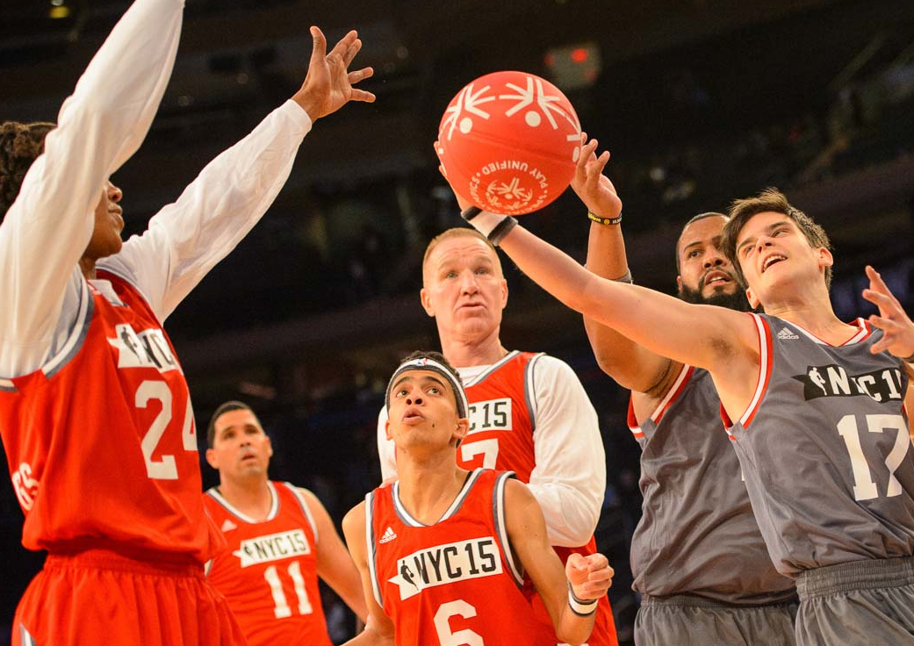
A picture paints a thousand words
It’s Time For Special Olympics Version 2.0
Our next chapter will feature marketing that reframes our message:
A messaging emphasis on radical inclusion
A digital/mobile first approach
A focus on deep relationship building
Positioning ourselves as more than a charity
A focus on immersive experiences
Use the Picture and Caption format to create strong compelling slide like this. Don’t’t forget to caption where possible. For best effect crop the image to fill the placeholder.
3 / Special Olympics
Notes:
We need to awaken the joyous rebellion at the core of our movement.

Slide 4
Our 50th Anniversary Celebration Marks

Slide 5
Special Olympics 2.0 Overview
Our End Goal
ENDING DISCRIMINATION AGAINST PEOPLE WITH INTELLECTUAL DISABILITIES
Business Objectives
RAISE $100M & ENGAGE 100M PEOPLE
Marketing Objectives
SHIFT PERCEPTIONS OF SPECIAL OLYMPICS AND PEOPLE WITH INTELLECTUAL DISABILITIES
RADICAL INCLUSION THROUGH SPORT (Bring people together with actionable activity that creates inclusion)
Brand Essence
& Action
Brand Line
To come in June.
Communicating the need for athletes to receive levels of fitness, skill, and health; Celebrating when those milestones occur.
Pillars
Inclusive Sport & Health
Unified Generation
Athlete Empowerment
Five-year fundraising campaign
Our Tools
Multiyear, multichannel marketing campaign.

Slide 6
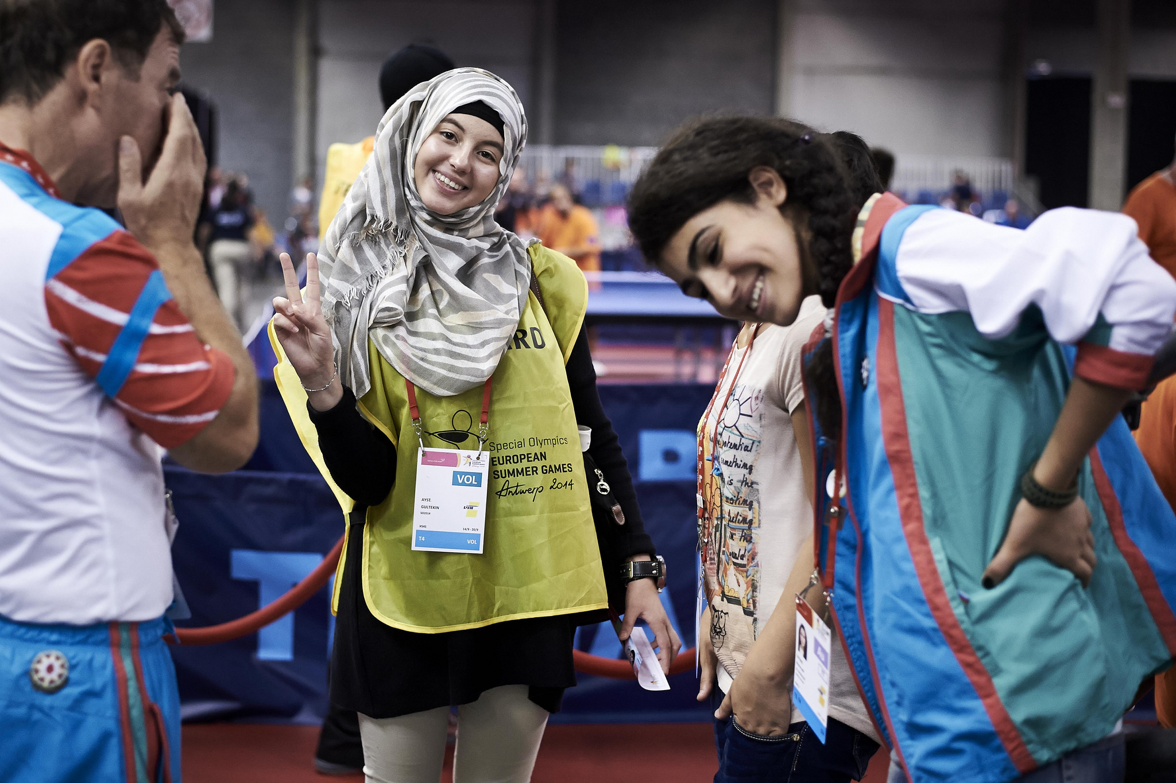
$100M Dollars &
100M People
Fundraising & Engagement Opportunities for Programs, Regions & SOI
Funding to Support Scope & Scale

Slide 7
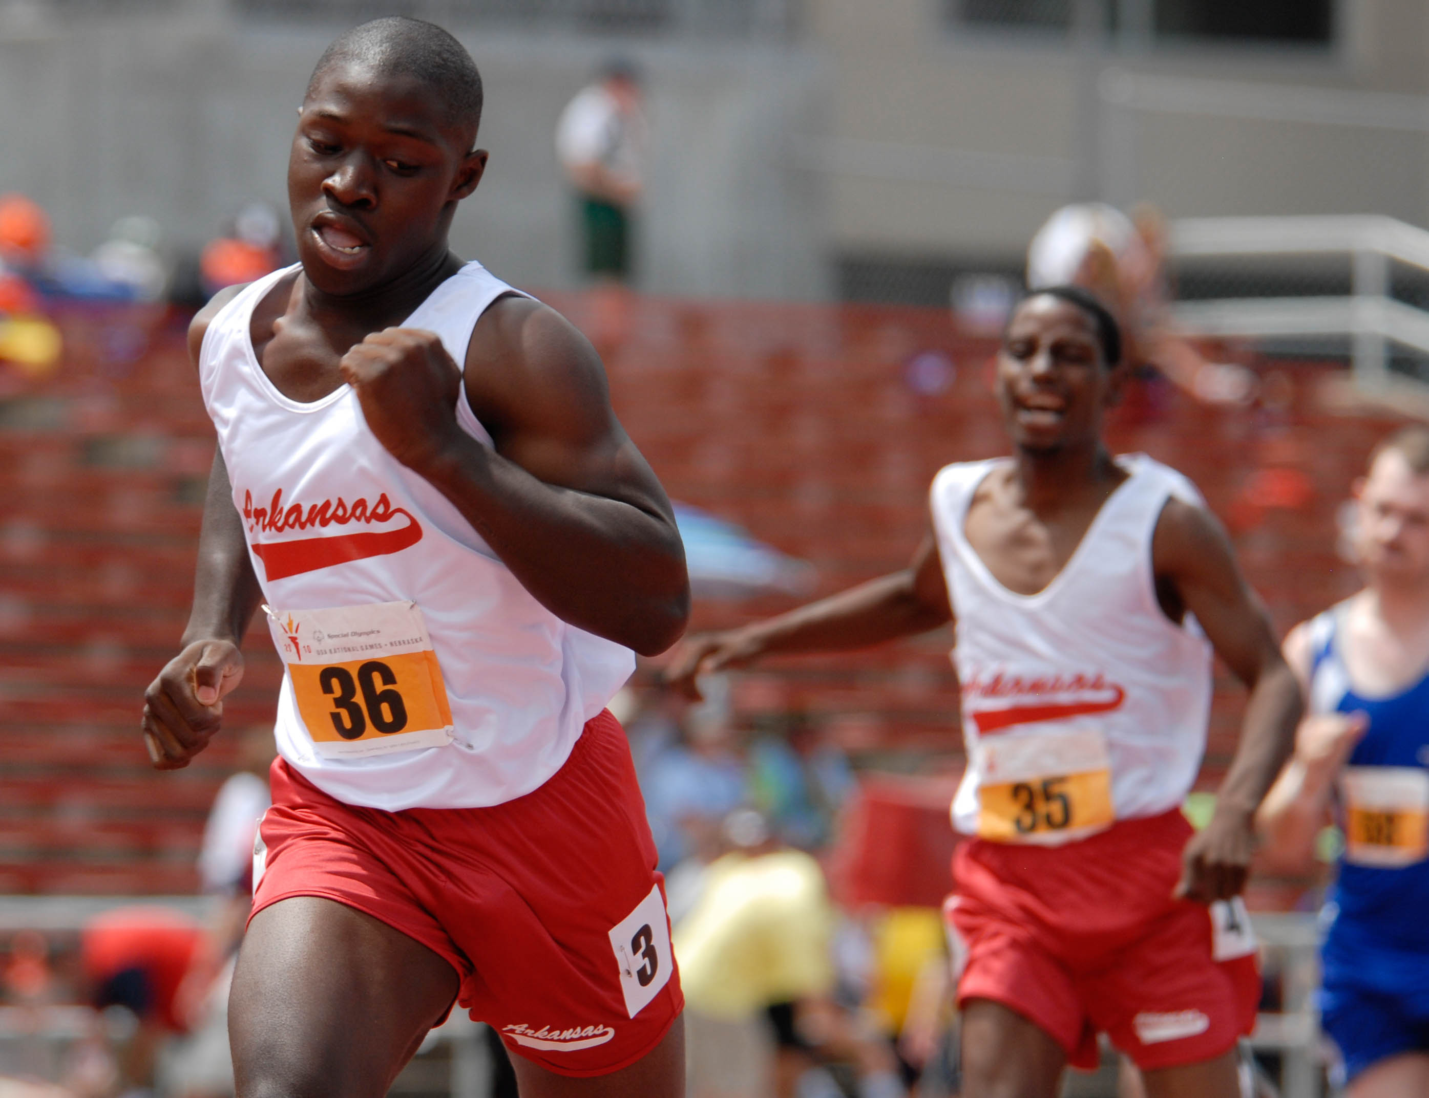
OPERATE TODAY,
SECURE THE FUTURE
40% Annual Fund
60% GameChanger Investment Fund
DONOR FLEXIBILITY
Regions
Pillars
Other Restrictions
Unrestricted

Slide 8
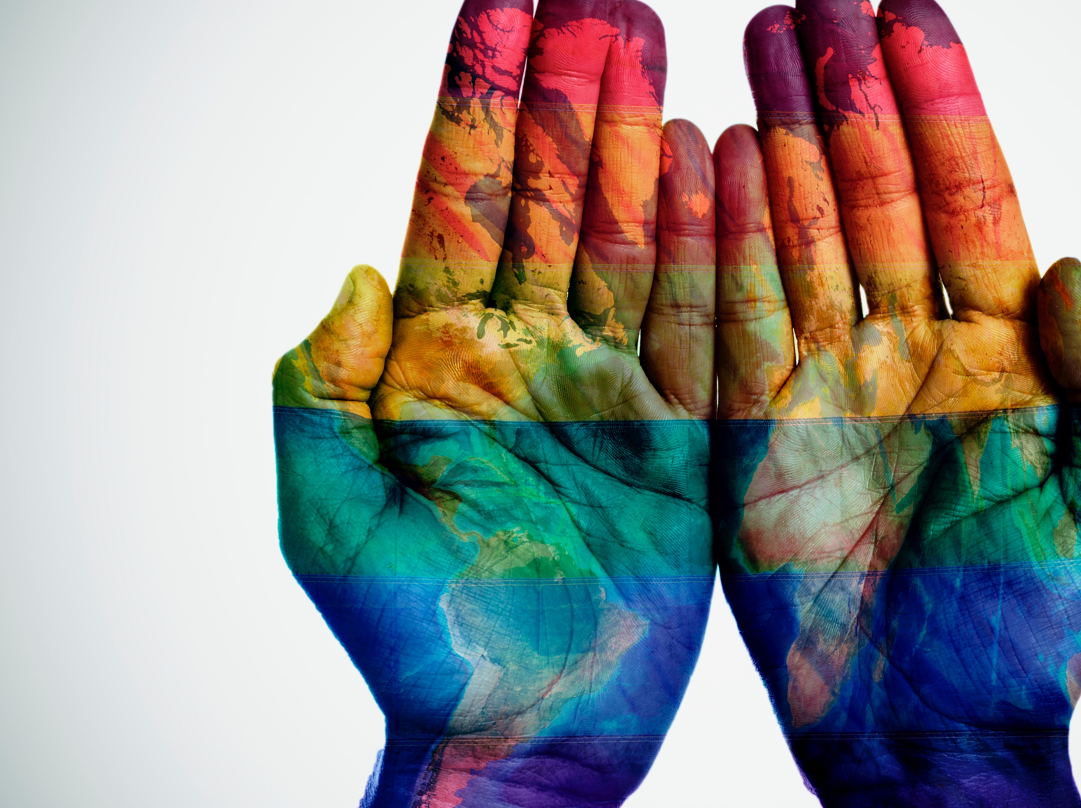
Program Collaboration
OPERATE TODAY – SECURE THE FUTURE
40% Annual Fund
60% GameChanger Investment Fund
DONOR FLEXIBILITY
Regions
Pillars
Other Restrictions
Unrestricted
Sales Materials to Meet Your Program’s/Region’s Needs
Collaborative Low Donor Opportunities
Digital Activations to Build Revenue & Donor Base
Events: Chicago 2018
Corporate/Foundation/ Strategic Gifts/Events
8 / Special Olympics

Slide 9
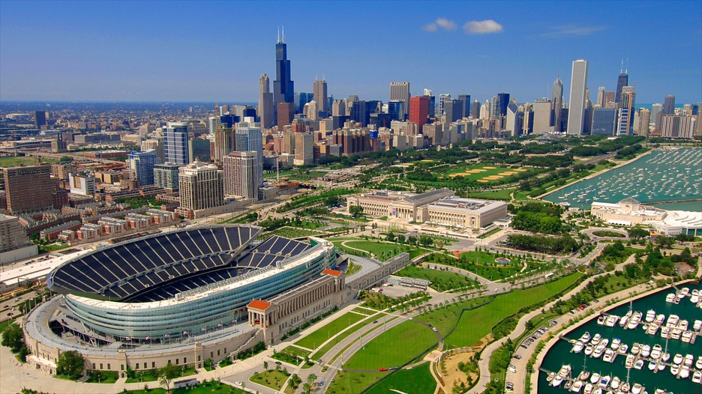
50th Anniversary Chicago Event Calendar
Tuesday 17th July | Unified Football Cup Divisioning/ Group Stages
Wednesday 18th July | Unified Football Cup Group Stages
Thursday 19th July | Unified Football Cup Group Stages
Friday 20th July | Unified Football Cup Semi Finals & Finals
Saturday 21st July | 50th Anniversary Concert | Global Day of Inclusion

Slide 10
Special Olympics
Unified Football Cup
Tuesday 17th July | Divisioning/ Group Stages
Wednesday 18th July | Group Stages
Thursday 19th July | Group Stages
Friday 20th July | Semi-Finals & Finals
24 Teams
2 Divisions for men, 2 Divisions for women
Engage professional teams
International Champions Cup Tie-In
Notes:
24 Teams (8 Women’s, 16 Men’s)
2 Divisions for Women, 2 Divisions for Men
Each team’s travel and kit supported by a Federation, Professional Club or other donor
Hosted by Chicago Fire MLS team
Seeking tie-in with International Champions Cup

Slide 11
Eternal Flame of Hope & LETR Torch Run
Symbol of Special Olympics spirit
Permanent legacy of the 50th celebrations
High profile location and sculptor
Lighting ceremony and Torch Run

Slide 12
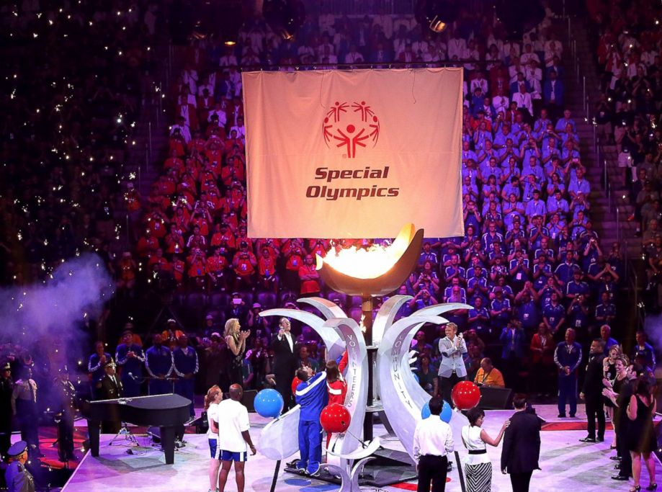
Signature 50th Anniversary Concert
A-level celebrities
Raise money
Reach a global audience

Slide 13
Global Day of Inclusion
(July 21, 2018)
Honor the past at Soldier Field
Look to the future – Play Unified
Engage with Athletes from 1968 and present day
Raise awareness and educate
Notes:
Only for 2018 - Starting this year Eunice Kennedy Shriver Day will move to 20 July 2017 and continue in 2019 and beyond on 20 July

Slide 14
2017
2019
2018
2020
2021
Quiet Phase
Launch
Sustain
Ongoing Major Donor and Corporate Solicitation May –Sales Packet Arrive at Regional Offices
Jun – Share marketing campaign and begin training
Jul– Celebrate Champions Month (US Corp Pilot, Digital Tie-in)
Jul –move Eunice Kennedy Shriver Day to 20 July
Jul – Announce 50th Plans publically
Jul-Sep - Digital Donor Acquisition Campaigns
Nov- Mid Level Donor Cultivation (Int’l Digital – 360 Experience)
Jan- Campaign Webpage Active
Jan- Davos World Economic Forum
Jan -Digital Countdown to the 50th (Int’l Monthly Give-Aways)
Jan- Golden Globes Campaign
Jan-Wearable Launch (Int’l Low Level Entry Point)
Mar-MENA Games (Pre-Games)
Mar-Guinness Book of World Records Digital Activation (Int’l)
Apr- “It Takes 3 Minutes” Pledge: Inclusion “Pledge” Corporate and Digital Activation (Int’l)
Apr- Major Donor Experience (SOAfrica)
Jun-Mid Level Donor Cultivation (Digital – 360 Experience)
Jun- SO Past and Future Digital Activation
July – USA Games and Digital Activation Seattle
July-Chicago 50th Events and Digital Activation
Aug-Sept – Acquisition(Int’l) Ask public to take the “What Are Your Chances Challenge” online
Sept- Major Donor Experience (Location TBD)
Nov- Mid Level Donor Ask (Int’l Digital – 360 Experience)
Dec - VR 50th and AVSC Anniversary Celebrations
Jan-2018 Digital Recap Campaigns
Mar-World Games Digital Experience
Mar -Abu Dhabi World Games
May-Jun- Major Donor Experience (Location TBD)
July- Hyannis Port Engagement
July- First of Next 50 Years Digital Campaign
Q1- World Winter Games
Dec- Campaign End Celebration (Location TBD)

Slide 15
2017: Program Call to Action
1. Call, e-mail, or text when you have stories, pictures, videos or opportunities
2. Engage your regional presidents or managing directors for any special events or initiatives
3. Think big when it comes to potential regional and/or global partners, donors & foundations
4. Share this presentation with your Program board of directors
5. Partner with SOI to raise $100M
May: Review digital and hard copy campaign packages
June: Identify 1-2 potential international or regional corporate partners within your Region
July: Use the digital toolkit to execute digital giving month initiative (US)
Aug-Sep: Digital Acquisition – Ask public to take the “What Are Your Chances Challenge” online (International)
6. Partner with SOI to engage 100M people
Use current Special Olympics hashtags: #PlayUnified #SpecialOlympics #ChangeTheGame #UnifiedGeneration #InclusiveHealth #LETRforSO #Rword
Stay tuned for marketing assets and language coming in July!
7. Partner with SOI to celebrate the 50th anniversary
- Celebrate “Global Day of Inclusion” by conducting a unified event on July 21, 2018
- Consider sending a representative to be part of the celebrations in Chicago

Slide 16
Thank you!

